Slide 1
Empowering Global AMR Research Community: Interactive GIS Dashboards for AMR Data Analysis and Informed Decision-Making

Slide 2





Meet the Team
Stephen Obol Opiyo, PhD
Data/Bioinformatics Scientist
Patira Data Science, USA
Dr. Stella Maris Nanyonga
Research Pharmacist
Oxford University, UK
Dr. Nathan Mugenyi
Global Health Researcher
Mbarara University, Uganda
Dr. Racheal Kasozi
Medical Doctor/Research Associate
Mengo Hospital, Uganda
Dr. Andrew Marvin Kanyike Medical Officer/Research Associate
Mengo Hospital, Uganda

Slide 3
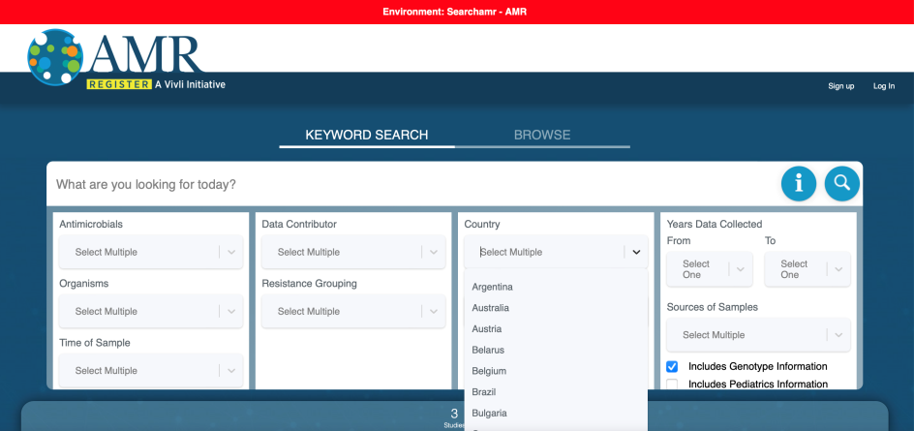
Challenges
300-word expression of interest submission:
Searched Vivli AMR database by Country
1) There was no data from Uganda in the Vivli database (May 2023).
Submitted abstract by title: “Unleashing the Power of AI: Harnessing Vivli Data from Kenya to Unlock the Untapped Potential of AMR Data from Uganda”

Slide 4
Challenges
Abstract accepted, data provided (2023_06_15 atlas_antibiotics.csv).
Data for 18 years (2004 to 2021), 83 countries, 126 variables, 345 species, and 863,509 isolates
2) Kenya three years (2013, 2014, 2021), and Uganda (2021)
3) The African region had the lowest number of datasets and the fewest years of available data

Slide 5
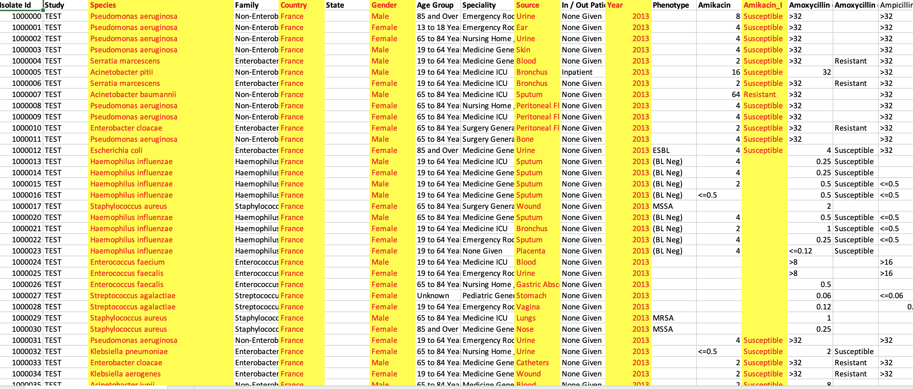
Challenges
4) Challenge of going through spreadsheet of spreadsheet of 863,509 rows with 126 columns

Slide 6
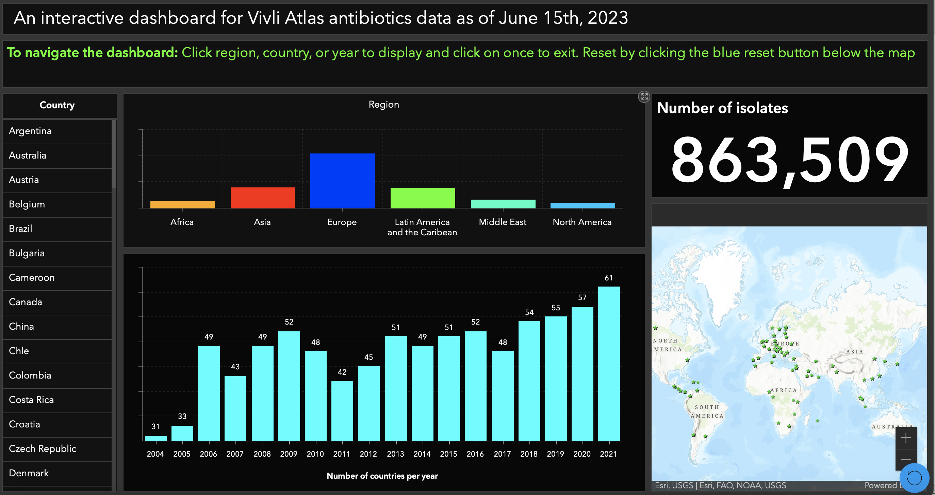
Our solutions
An interactive (GIS) dashboard encompassing all countries within the Vivli dataset
https://patira.maps.arcgis.com/apps/dashboards/d89c5b039552464f8f04103f05ac889f

Slide 7
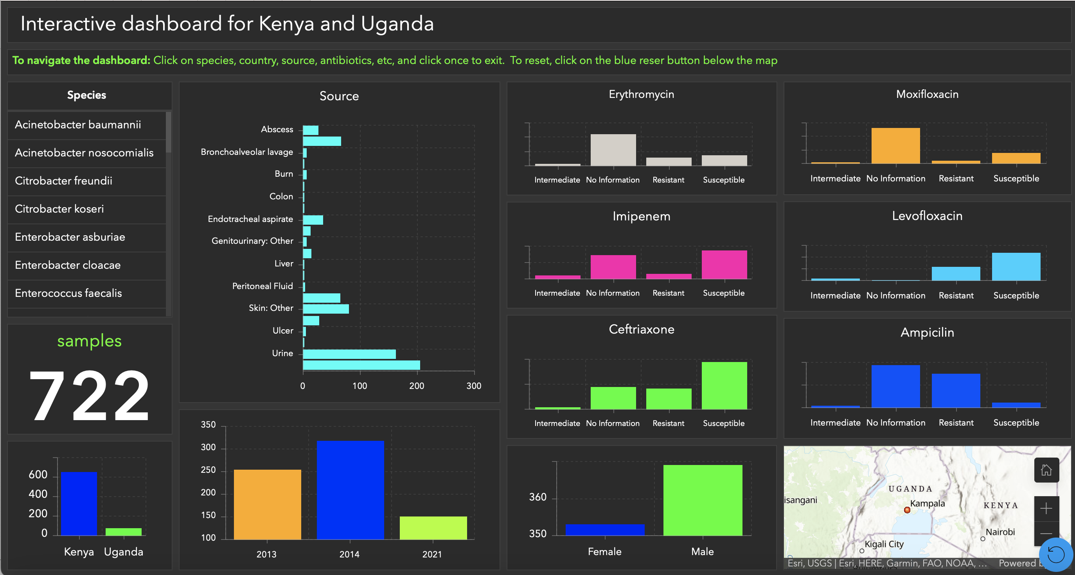
Our solutions
An interactive GIS dashboard specific to the datasets from Kenya and Uganda
https://patira.maps.arcgis.com/apps/dashboards/a1324c58e49e4561ac9505936db7743a

Slide 8
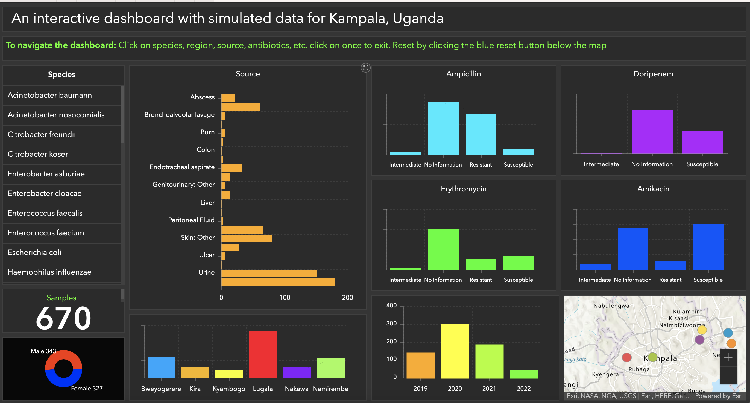
Our solutions
A simulated dataset specifically for Kampala, Uganda
https://patira.maps.arcgis.com/apps/dashboards/095acc30606c4c7a8bc8260e6160c511

Slide 9
Impact of the work (Healthcare professionals)
The dashboard provides real time information that guides decisions on the choice of antibiotics/antimicrobials to use and infection control measures
The dashboard will make the detection of outbreaks easy by showing clusters of cases in a specific region or health facility
Visualization of health data will guide managers of health facilities where to allocate more resources so that the effective therapies are available.

Slide 10
Impact of the work (Policymakers)
Dashboard combines health, lab, genomic, and surveillance data for comprehensive analysis and insight.
Spatial analysis reveals resistant pathogen distribution, aiding resource allocation, AMR intervention, and surveillance enhancement.
Real-time health data informs intervention impact by tracking resistant microbes, aiding decisions for improved outcomes.
GIS dashboards can be used for effective surveillance for different areas including those with limited access to health services.

Slide 11
Impact of the work (Researchers)
The dashboard can combine data on demographics, health facilities, antibiotic use and other factors enabling risk assessment studies to identify factors that contribute to the emergence and spread of resistance.
The dashboard enables data sharing which fosters communication and collaboration.
Real-time health data informs intervention impact by tracking resistant microbes.
Stored historical data can be used for developing predictive models for the spread of resistant pathogens to anticipate future outbreaks and inform preparedness measures.

Slide 12
Acknowledgments
The Vivli AMR Team
Welcome
The judging panel
This presentation is based on research using data from (2023_06_15 atlas_antibiotics; Pfizer), obtained through https://amr.vivli.org

Slide 13
Demonstration of the dashboards

Slide 14
Questions????

